Slide 1
IE 362 Lecture 13: Graph
Il-Chul Moon
Department of Industrial and Systems Engineering
KAIST

Slide 2
Short recap

Slide 3
DFS vs. BFS traverse on graphs
DFS utilizes
Stacks, or recursions that imitates the stack operations
Pre-order traverse
In-order traverse
Post-order traverse
In graphs, often only pre-order traverse is used
BFS utilizes
Queues
Lever-order traverse
Having said this,
Tree is a directed acyclic graph.
Graph may not be a DAG
Then….
You have to check the repeated visits to avoid falling into a cycle
0
2
1
3
5
7
4
9
6
8

Slide 4
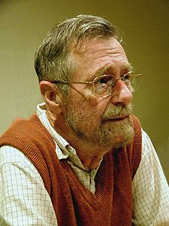
Dijkstra’s algorithm
Computer science is no more about computers than astronomy is about telescopes.
Memoization Table
V = the set of vertexes
W = the set of weights on edges
s = the source vertex
Dijkstra’s algorithm(V, W,s)
dist = {}
For itr in V
dist[v] = 99999
dist[s] = 0
While size(V) != 0
u = getVertexWithMinDistance(V, dist)
V.remove(u)
For neighbor in getNeighbors(u)
If dist[neighbor] > dist[u]+w(u,neighbor)
dist[neighbor] = dist[u]+w(u,neighbor)
Return dist
Retrieving minimum distance from a list. Does that ring a bell?
S
(0)
20
9
D (20)
3
(9)
4
Will I update the time 20 with time 9+4?
Somehow, I know it takes 9 to reach 3

Slide 5
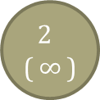
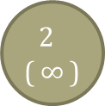
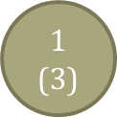
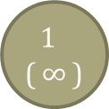
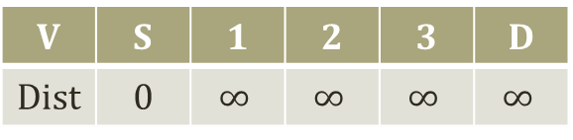
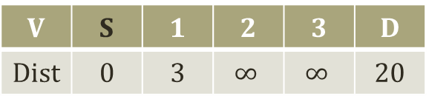
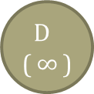
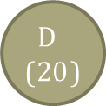
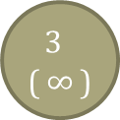
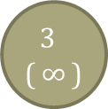
Progress of Dijkstra’s algorithm (1)
S
(0)
20
S
(0)
20
2
($∞$)
2
($∞$)
3
5
3
5
1
($∞$)
1
($3$)
7
7
6
15
15
6
D ($∞$)
D ($20$)
3
($∞$)
3
($∞$)
4
4
V | S | 1 | 2 | 3 | D
Dist | 0 | $$∞$$ | $$∞$$ | $$∞$$ | $$∞$$
V | S | 1 | 2 | 3 | D
Dist | 0 | 3 | $$∞$$ | $$∞$$ | 20

Slide 6
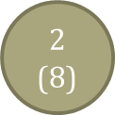
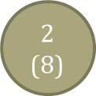
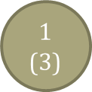
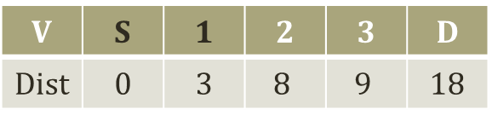
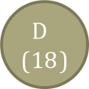
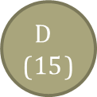
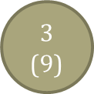
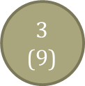
Progress of Dijkstra’s algorithm (2)
S
(0)
20
S
(0)
20
2
($8$)
2
($8$)
3
5
3
5
1
($3$)
1
($3$)
7
7
6
15
15
6
D ($18$)
D ($15$)
3
($9$)
3
($9$)
4
4
V | S | 1 | 2 | 3 | D
Dist | 0 | 3 | $$8$$ | $$9$$ | 18
V | S | 1 | 2 | 3 | D
Dist | 0 | 3 | 8 | 9 | 15

Slide 7
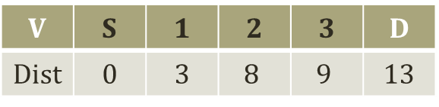
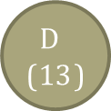
Progress of Dijkstra’s algorithm (3)
Time complexity
O( (|E|+|V|)log|V| )
We will not prove this
|E|
The number can vary
It can be close to
|V| X (|V|-1) = dense graph
0 = sparse graph
If it is a dense graph,
|E| is almost equal to |V| X (|V|-1)
Then?
O( |V|²log|V| )
More than a quadratic time complexity
Pretty expensive!
S
(0)
20
2
($8$)
3
5
1
($3$)
7
6
15
D ($13$)
3
($9$)
4
V | S | 1 | 2 | 3 | D
Dist | 0 | 3 | $$8$$ | $$9$$ | 13

Slide 8
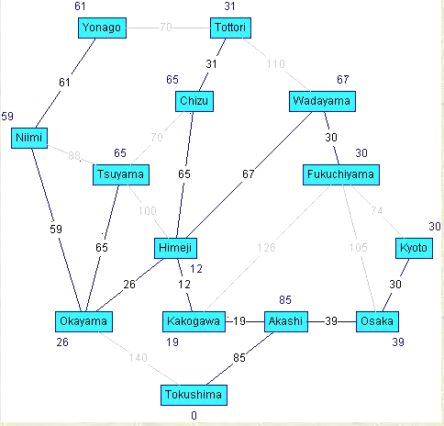
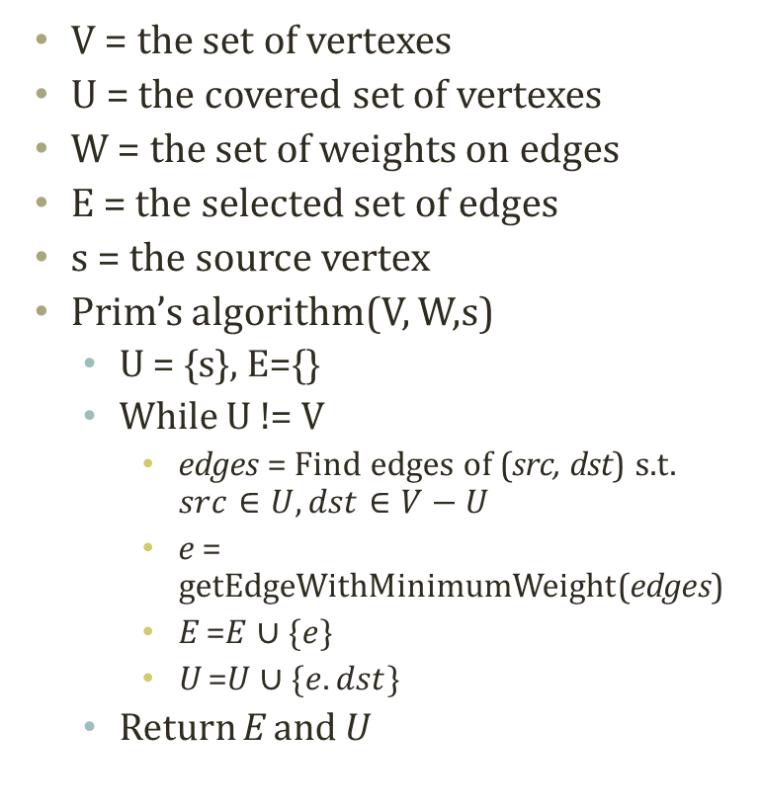
Prim’s algorithm
V = the set of vertexes
U = the covered set of vertexes
W = the set of weights on edges
E = the selected set of edges
s = the source vertex
Prim’s algorithm(V, W,s)
U = {s}, E={}
While U != V
edges = Find edges of (src, dst) s.t. $src∈U, dst∈V−U$
e = getEdgeWithMinimumWeight(edges)
E =$E∪\{e\}$
U =$U∪\{e.dst\}$
Return E and U
Uncovered Nodes
Covered Nodes
3
1
3
Edges of don’t care
15
9
4
5
Edges of don’t care
13
Edges of don’t care
2
2
20
5
Edges to consider

Slide 9
Progress of Prim’s Algorithm (1)
1
20
1
20
4
4
3
5
3
5
2
2
7
7
6
15
6
15
5
5
3
3
4
4
V={1,2,3,4,5}
U={1}
E={}
V={1,2,3,4,5}
U={1,2}
E={(1,2)}

Slide 10
Progress of Prim’s Algorithm (2)
1
20
1
20
4
4
3
5
3
5
2
2
7
7
6
15
6
15
5
5
3
3
4
4
V={1,2,3,4,5}
U={1,2,4}
E={(1,2),(2,4)}
V={1,2,3,4,5}
U={1,2,3,4}
E={(1,2),(2,4),(2,3)}

Slide 11
Progress of Prim’s Algorithm (3)
Time complexity
O( (|E|+|V|)log|V| )
We will not prove this
Same time complexity to the Dijkstra’s algorithm
1
20
4
3
5
2
7
6
15
5
3
4
V={1,2,3,4,5}
U={1,2,3,4,5}
E={(1,2),(2,4),(2,3),(3,5)}

Slide 12
Offline class plan

Slide 13
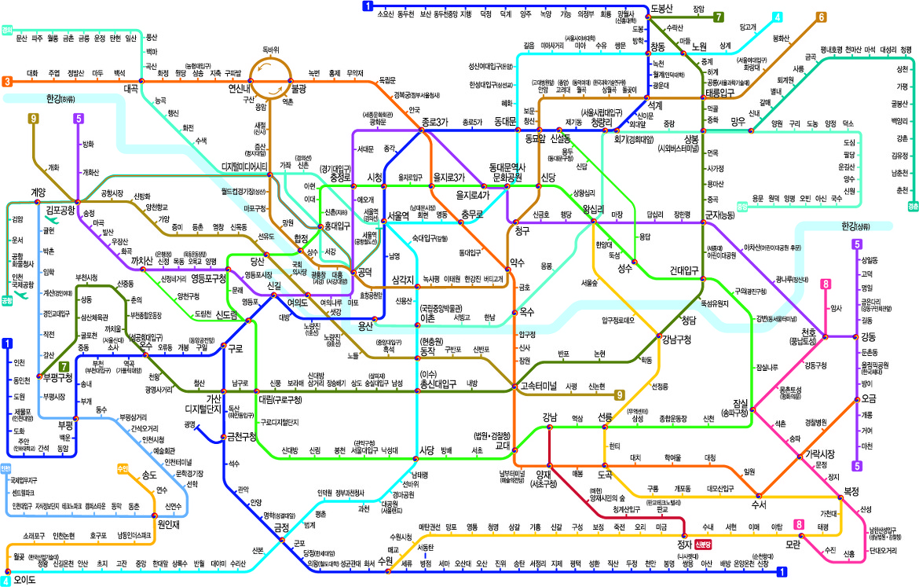
Subway Network
Seoul has the best subway station network.

Slide 14
To-Do: Shortest Path Finding
Complete ‘Dijkstra.py’
Read ‘Dijkstra.py’ and ‘Graph.py’
To-Do 1: Complete ‘performDijkstra’ in ‘Dijkstra.py’
You need to consider the memoization table as well as the back-trace table
Should be able to print the minimum cost and the shortest route
Dijkstra’s algorithm(V, W,s)
dist = {}
For itr in V
dist[v] = 99999
dist[s] = 0
While size(V) != 0
u = getVertexWithMinDistance(V, dist)
V.remove(u)
For neighbor in getNeighbors(u)
If dist[neighbor] > dist[u]+w(u,neighbor)
dist[neighbor] = dist[u]+w(u,neighbor)
Return dist

Slide 15
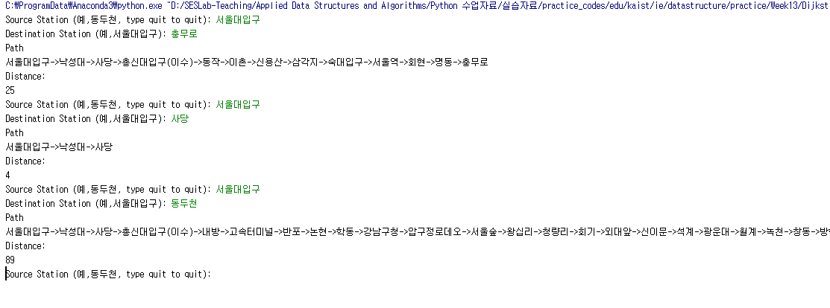
Expected Result
Execute ‘Dijkstra.py’
You need to input the station names

